Slide 1
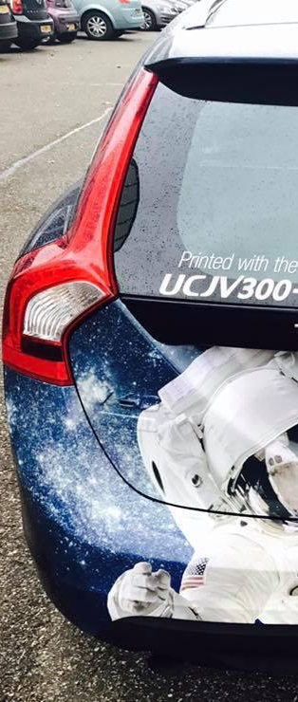
PRODUCT GUIDE
LUS-170
UV-LED Flexible ink
30-11-2017
V0.1EU
The information in this document is subject to change without notice.

Slide 2
LUS-170 LED-UV ink
Newly developed environmentally friendly LED curable UV ink
Creating more special effects with LUS-170
  Specially developed for 4-layer print, such as Day&Nigh effect
Stretchable up to 170%
Low VOC, Nickel free
GREENGUARD Gold certified
High color density
High scratch and chemical resistance
  High scratch resistance of LUS-170 allows printing on media such as tarpaulin without need for lamination after printing
Available in 8 different colors: Cyan, Magenta, Yellow, Black, Light cyan, Light magenta, White and Clear

Slide 3
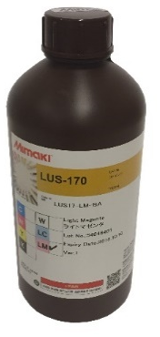
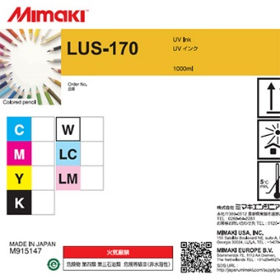
Ink pack details
Part No. | Description | Volume | Packaging | Applicable printer |  | Shelf lifetime
LUS17-C-BA-1 | LUS-170 UV Curing Ink Cyan | 1L | Bottle | UCJV150-160 | UCJV300-75/107/160 | 12 months after production date
LUS17-M-BA-1 | LUS-170 UV Curing Ink Magenta
LUS17-Y-BA-1 | LUS-170 UV Curing Ink Yellow
LUS17-K-BA-1 | LUS-170 UV Curing Ink Black
LUS17-LC-BA-1 | LUS-170 UV Curing Ink Light Cyan
LUS17-LM-BA-1 | LUS-170 UV Curing Ink Light Magenta
LUS17-W-BA-1 | LUS-170 UV Curing Ink White
LUS17-Cl-BA-1 | LUS-170 UV Curing Ink Clear
Ink label
Ink pack

Slide 4

LUS-170 LED-UV ink: Color Gamut
 | LUS-170 | LUS-200
Colors
Features | Stretchable up to 170% Flexible enough to fold Ink film is less likely to crack by folding or cutting Good media compatibility GREENGUARD GOLD certified ink Avery ICS warranty Program | Stretchable up to 200% Ink film is less likely to crack by folding or cutting High outdoor durability 3M™ MCS™ Warranty guarantees up to 6-year outdoor durability
Applications | Indoor signage and outdoor signage Printing on the material which requires post processing such as cutting or heating | Outdoor vinyl signage* Vehicle wrapping
C
M
Y
C
M
Y
CC
K
Lc
Lm
Cl
W
CC
K
W
* LUS-200 is not suitable to print on tarpaulin and banner material
Y
R
G
Measurement condition:
LUS-170
Ink Set: CMYK
Model: UCJV300-160
Print Mode: 600x600, 16P
Ink Limit: OFF
Color matching: OFF
Material: SPC-706
LUS-200
Ink Set: CMYK
Model: UCJV300-160
Print Mode: 600x600, 8P
Ink Limit: OFF
Color matching: OFF
Material: SPC-706
M
C
B

Slide 5
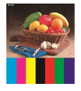
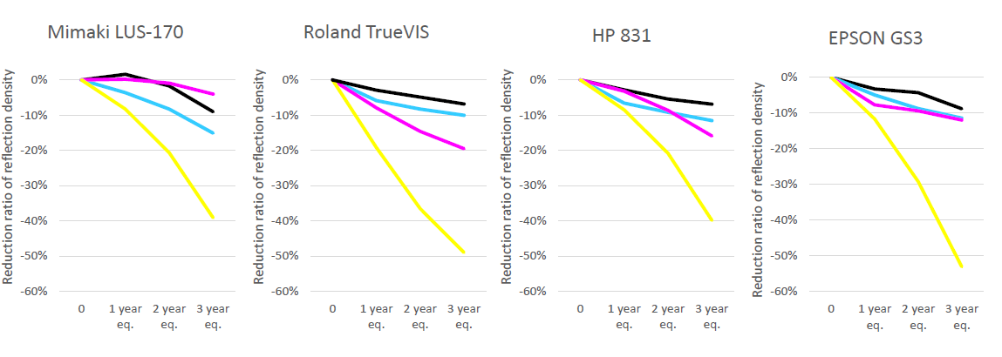
Outdoor durability
Data
Test condition:
Outdoor durability condition: ISO11341-1
Irradiation: 60 W/M² consistently
Black panel temperature: 65°C
Examination tank temperature: 38°C
Relative humidity: -70%
Shower: 18 min every 2h
RIP Software
Mimaki: RasterLink 6 plus
HP, Epson: ONYX
Roland: Versaworks Dual
Media: PWS-G(PVC)
The durability of LUS-170 Yellow is slightly less because it is nickel-free ink
The solvent resistance of LUS-170 is less because of its flexibility. Ink comes off by scratching with liquid, Ethanol 30%
With the post processing by screen printing (solvent) varnish, LUS-170 ink layer may dissolve
The use of solvent and adhesive agent on the material printed by LUS-170 is not recommended
Please test beforehand applications which require solvent resistance

Slide 6
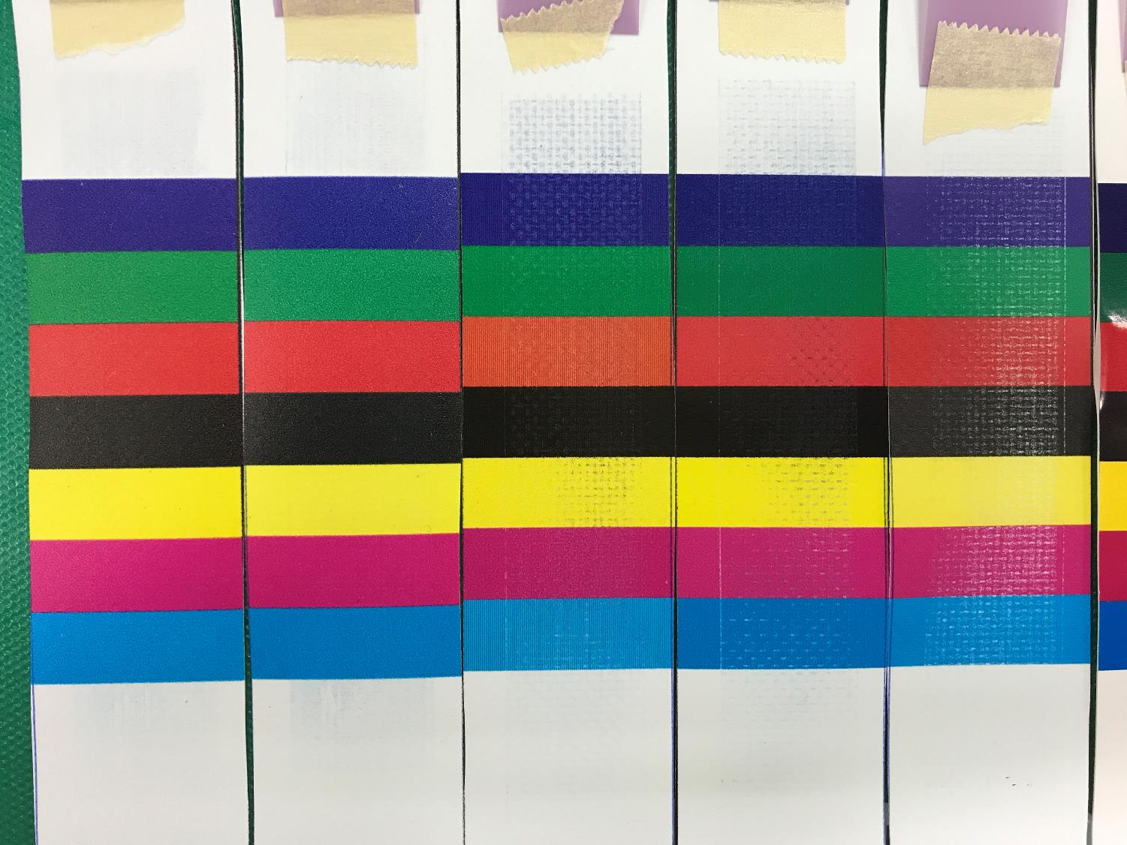
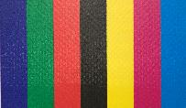
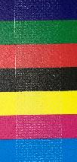
Scratch resistance
Superior scratch resistance compared to solvent or latex print technologies
 | Mimaki LUS170 | HP HP 831 | Roland TrueVIS | EPSON GS3
Scratch resistance evaluation test | Excellent | Acceptable | Acceptable | NG
Test method:
Machine: Scratchiness tester RT-300
Scratchiness Paper : Sand Paper #400
Scratching time: 10 front-back motion
Media: Hiraoka SJT-V200F (Banner)

Slide 7
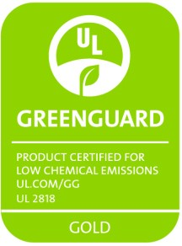

Certificates
GREENGUARD Gold Certification for LED-UV inks
  Mimaki LED-UV ink LUS-170 is GREENGUARD GOLD certified.
  Products that are GREENGUARD GOLD certified meets the rigorous standards for low emission of volatile organic compounds (VOCs) and ensures that a product is acceptable for use in environments such as schools and healthcare facilities.
ICS Performance Guarantee
  The ICS Performance Guarantee assures the performance of Avery films with a printing platforms when customers are working according to the relevant Avery Dennison Technical Bulletins associated with that product

Slide 8
Thank you
MIMAKI EUROPE B.V.

Slide 9
Revision history
Version | Date | Content | Drafter
0.1EU | 30-11-2017 | Draft | Product Management EMEA
0.2EU | 17-10-2018 | Draft | Product Management EMEA
Do not disclose this page

